Slide 1
Hand Written Text Recognition

Slide 2
Mentor & Team
Mentored & Motivated By
Prof. Piyal Sarkar
(IT HOD)
Working Team
  Shrikant Kumar
  Sumit Kr Trivedi
  Shashikant Pathak
  Vivek Kr Kushwaha

Slide 3
Objectives
We have to develop a Graphical User Interface in which a user will input an image and the system will return the text in that image

Slide 4
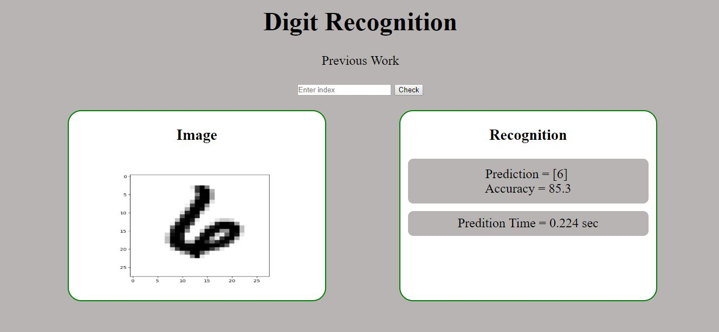
Previous Work

Slide 5
Requirements
Software
  Windows OS
  Python 3
  Code Editor
Hardware
  Laptop or Desktop
  Mobile Camera Scanner Or simply Scanner

Slide 6
Steps to do
Create virtual environment and activate it.
Install Pillow and pytesseract library.
Install Flask
Write Python scripts to recognize text in image.
Develop a simple GUI

Slide 7


Flow Diagram
Input Image
Pillow Library
Pre-Processing
String in Image
Pytesseract
String Recognition
Output Text

Slide 8
Image Pre-Processing
Pre-processing includes steps that are required to shape the input image into a form suitable for recognising text.
We are using Python Image Library to load the image and create an instance of it for further transformation of image into string.

Slide 9
String Extraction & Recognition
In this step we are extracting string from our pre-processed image
For extracting string from pre-processed image, we are using pytesseract library.
  image_to_string() function of pytesseract is used to extract string.

Slide 10
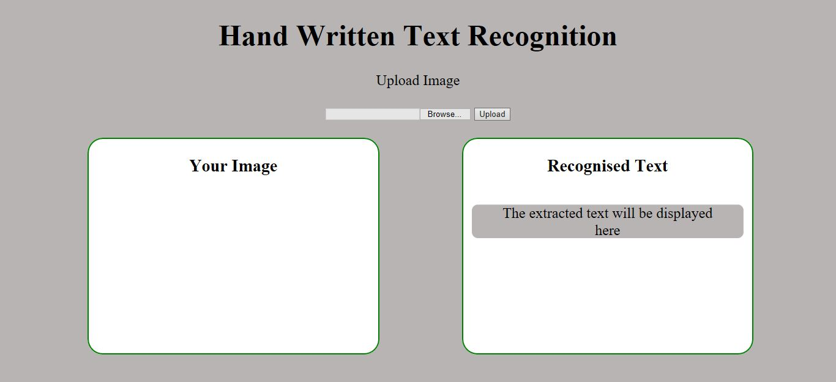
GUI
We have developed simple Graphical User Interface using HTML and CSS.

Slide 11
Web Server
We have used flask framework to build our web application.
The backend script in python will run on flask web server.

Slide 12
Integration
We need to connect GUI file to python scripts which will recognize text. So we need a file which will route GUI file to python script.
The request from user interface is handled by a python script which will route to recognize text as per request.

Slide 13
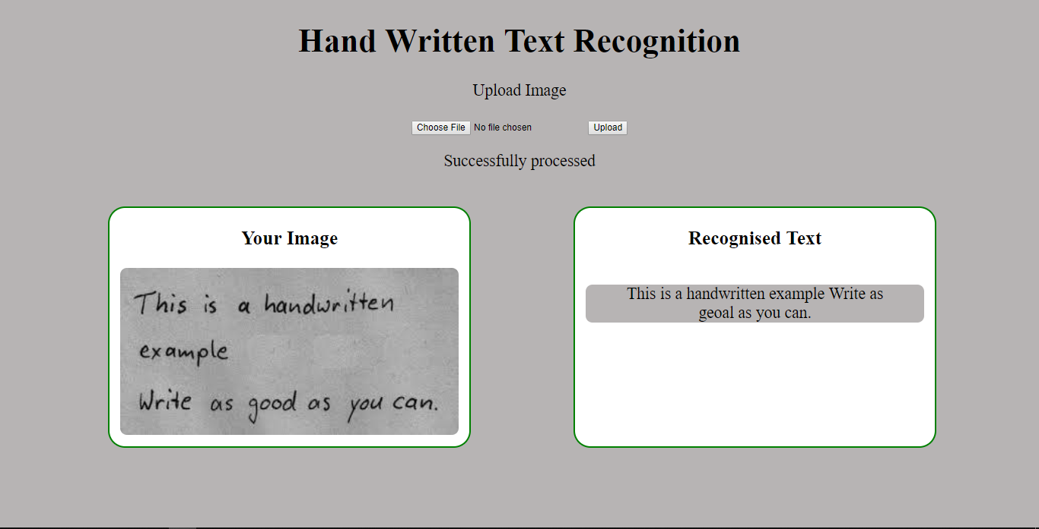
Testing
Test Case 1

Slide 14
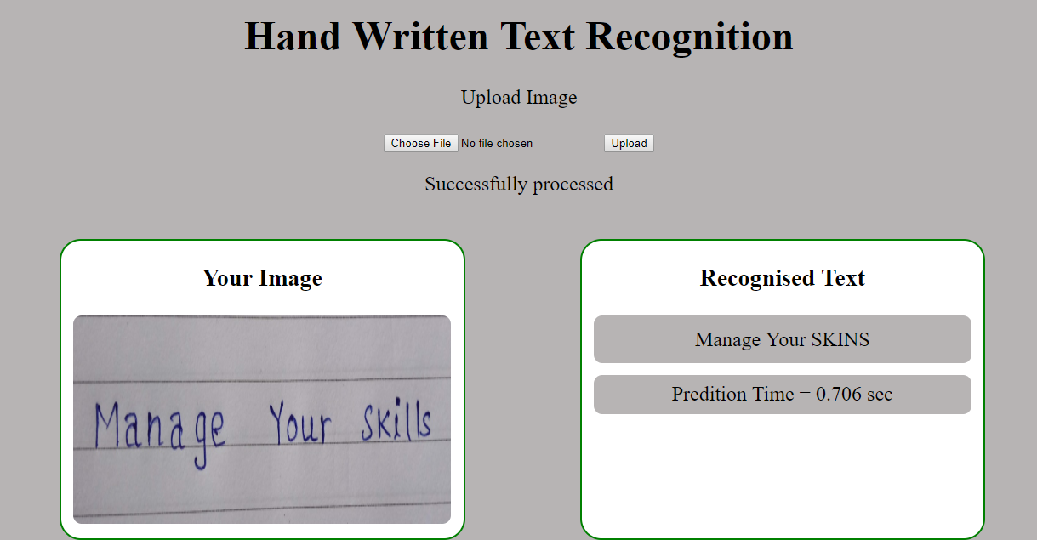
Test Case 2

Slide 15
Test Cases Comparison
The text recognition on Test Case 1 is much better than the than the Test Case 2.
As we can see the lines in Test Case 1 are thicker and there's better contrast between the text and the background. This could be the reason for the better recognition in Test Case 1.

Slide 16
Observation
We observed that the text recognition from Hand Written images is almost 100 % accurate if we take a good quality of input image having good dpi and resolution and also a good contrast between text and background.
However it worked well with computerized images having computerized fonts

Slide 17
References
https://stackabuse.com/pytesseract-simple-python-optical-character-recognition/
https://www.youtube.com/watch?v=uU1LHp-wFDQ
https://www.youtube.com/watch?v=aZsZrkIgan0
https://www.kaggle.com/c/digit-recognizer/data
https://scikit-learn.org/stable/

Slide 18
Thank You

